Slide 1
Software Engineering
CS60002
Lecture 08
Interaction Diagrams

Slide 2
Lecture #09
What is a sequence diagram?
Basic components in any sequence diagram and their notations
Illustration of applications in Modeling
Collaboration diagrams

Slide 3
Interaction Diagrams
Interaction diagrams model how groups of objects collaborate in some behavior
There are two types of interaction diagrams
  Sequence diagrams
  Collaboration diagrams

Slide 4
Sequence Diagram

Slide 5
What is a Sequence Diagram?
A sequence diagram shows object interactions arranged in time sequence
It depicts the object and classes involved in the scenario and the sequence of messages exchanged between the objects needed to carry out the functionality of the scenario
Typically, a sequence diagram captures the behavior of a single activity or a use case

Slide 6
Basic of a Sequence Diagram
A sequence diagram is a two dimensional chart
The chart is read from top to bottom
The objects participating in the interaction are shown at the top of the chart as boxes attached to a vertical-dashed line
Inside the box the name of the object is written with a colon separating it form the name of the class and both the name of the class and object are underlined
Some times an anonymous object (only class name and underlined) is also used

Slide 7
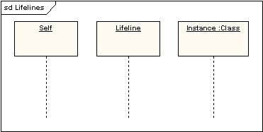
Life Line in a Sequence Diagram
A lifeline represents an individual participant in a sequence diagram. A lifeline will usually have a rectangle containing its object name. If its name is self then that indicates that the lifeline represents the classifier which owns the sequence diagram

Slide 8
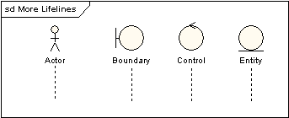
Life Line in a Sequence Diagram
Sometimes a sequence diagram will have a lifeline with an actor element symbol at its head. This will usually be the case if the sequence diagram is owned by a use case. Boundary, control and entity elements form robustness diagrams can also own lifelines

Slide 9
Example: Objects and Life Line

Slide 10
Objects and Life Time
The objects appearing at the top signifying that the object already existed when the use case execution was executed.
However, if some object is created during the execution of the use case and participates in the interaction, then that object should be shown at the appropriate place on the diagram where it was created
The vertical dashed line in the sequence diagram is called the object’s life time. The life time indicates the existence of the object at any particular point of time
A rectangle is used on the life time to indicate the activation symbol and implies that the object is active as long as the rectangle exists

Slide 11
Example: Object’s Life Time

Slide 12
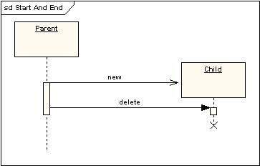
Start and End of Life Line
A lifeline may be created or destroyed during the timescale represented by a sequence diagram. In the latter case, the lifeline is terminated by a stop symbol, represented as a cross. In the former case, the symbol at the head of the lifeline is shown at a lower level down the page than the symbol of the object that caused the creation. The following diagram shows an object being created and destroyed

Slide 13
Messages in Sequence Diagrams
Two objects in a sequence diagram interacts with passing messages between them
Each message is indicated as an arrow between the lifelines of two objects
The order of message is very important in the sequence diagram. They should appear in chronological order from top to the bottom. That is, reading the diagram from the top of the bottom would show the sequence in which the message occurs
Each message is labeled with the message name

Slide 14
Example: Message in a Sequence Diagram

Slide 15
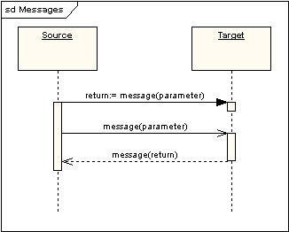
More on Messages
Messages can be synchronous or asynchronous; call or signal. In the following diagram, the first message is a synchronous message (denoted by the solid arrowhead) complete with an implicit return message; the second message is asynchronous (denoted by line arrowhead) and the third is the asynchronous return message (denoted by the dashed line)

Slide 16
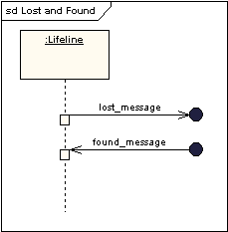
More on Messages
Messages can be lost or found. Lost messages are those that are either sent but do not arrive at the intended recipient, or which go to a recipient not shown on the current diagram. Found messages are those that arrive from an unknown sender, or from a sender not shown on the current diagram. They are denoted going to or coming from an endpoint element

Slide 17
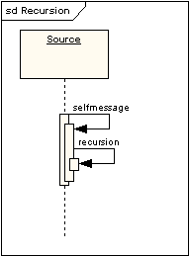
Self or Recursive Messages
A self message can represent a recursive call of an operation, or one method calling another method belonging to the same object. It is shown as creating a nested focus of control in the lifeline’s execution occurrence

Slide 18
Controlled Messages
Some control information can also be included
Two types of control information are particularly known:
  A condition (e.g. [vacant = true]) indicates that a message is sent, only if the condition is true
  An iteration marker (*) is used to indicate that the message is to be repeated many times to multiple receiver objects (e.g. when it is required to iterate over a collection or an array of elements)

Slide 19
Example: Controlled Message

Slide 20
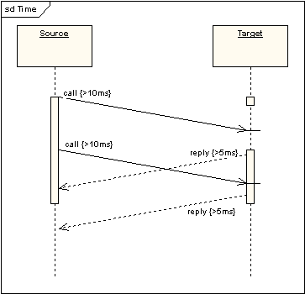
Duration and Timing Constraints
By default, a message is shown as a horizontal line. Since the lifeline represents the passage of time down the screen, when modeling a real-time system, or even a time-bound business process, it can be important to consider the length of time it takes to perform actions. By setting a duration constraint for a message, the message will be shown as a sloping line

Slide 21
Few Examples

Slide 22
ATM PIN Validation

Slide 23
Use Case Registration of OLP
Use case: Registration
Scenario 1: Customer is a staff member
Select customer type as staff.
Get data for a customer as staff.
Check the validity of the staff customer.
Alternative 1.1: Disqualify the validity of a staff
Message “Registration fail”.
Alternative 1.2: Qualify the validity of a staff
Check for already registered customer.
Alternative 1.2.1: Registration exist
Message “Registration fail”.
Alternative 1.2.1: Registration does not exist
Message “Registration successful”.
Create a new customer c.
Update record with c.
Scenario 2: Customer is other than staff
Select customer type as other.
Get data for a customer as other.
Check for already registered customer.
Alternative 2.1: Registration exist
Message “Registration fail”.
Alternative 2.2: Registration does not exist
Message “Registration successful”.
Create a new customer c.
Update record with c.

Slide 24
Sequence Diagram of Registration

Slide 25
Use Case Place Order in OLP
Use case: Order Items
Scenario 1: Option is new
Prompt for “Registration”
Call “Registration”
Display registration status
Exit
Scenario 2:Option is login
Call “Check In”
Alternative 2.1: Login is valid
Prompt for “Item Details”
Call “Create Order”
Display order status
Exit
Alternative 2.2: Login is invalid
Display login fail
Exit

Slide 26
Process Order in OLP System
To illustrate the drawing of a sequence diagram, let us consider the use case “Process Order ” in the OLP system
The “Process Order” use case is proposed to have a following behavior (or scenario)
    orderEntry: Window
      this object will get an order from a customer
    anOrder: Order
      receives an order from a customer (via orderEntry object)
    orderSet: ItemList
      an object is a list of items is to be processed

Slide 27
Sequence Diagram in OLP System
    stockist: InventoryManage
      object responsible for checking stock, supply stock, request for inventory etc.
    :OrderInfo
      containing the orders information in a queue
    confirmMessage: Message
      message objects for sending confirmation message
The sequence diagram for Process Order use case can be drawn as follows.

Slide 28
Sequence Diagram of Process Order use case in OLP System

Slide 29
Use of Sequence Diagram
From the sequence diagram of “Process Order” use case, it is evident that the diagram is easy to understand and has immediate appeal. This is the great advantage of the sequence diagram
However, in some situation, there may be a lot of small methods in different classes, and at times it can be very tricky to figure out the overall sequence of behaviors. in fact, so many details can be resolved during coding only
The development of sequence diagram would help a designer in determining the responsibilities of the different classes. i.e. what methods should be supported by each class, sequence of message passing etc.

Slide 30
Sequence diagrams in UML 2.0
  Fragments

Slide 31
Combined Fragments
A combined fragment is one or more processing sequence enclosed in a frame and executed under specific named circumstances. The fragments available are:
Alternative fragment (denoted “alt”) models if…then…else constructs.
Option fragment (denoted “opt”) models switch constructs.
Break fragment models an alternative sequence of events that is processed instead of the whole of the rest of the diagram.
Parallel fragment (denoted “par”) models concurrent processing.
Weak sequencing fragment (denoted “seq”) encloses a number of sequences for which all the messages must be processed in a preceding segment before the following segment can start, but which does not impose any sequencing within a segment on messages that don’t share a lifeline.

Slide 32
Combined Fragments
Contd…
Strict sequencing fragment (denoted “strict”) encloses a series of messages which must be processed in the given order.
Negative fragment (denoted “neg”) encloses an invalid series of messages.
Critical fragment encloses a critical section.
Ignore fragment declares a message or message to be of no interest if it appears in the current context.
Consider fragment is in effect the opposite of the ignore fragment: any message not included in the consider fragment should be ignored.
Assertion fragment (denoted “assert”) designates that any sequence not shown as an operand of the assertion is invalid.
Loop fragment encloses a series of messages which are repeated.

Slide 33
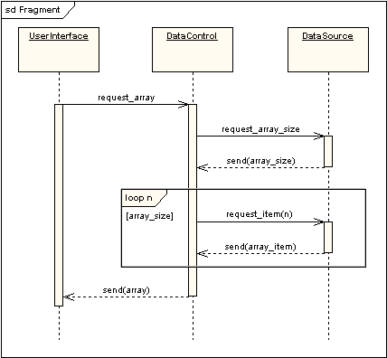
Example: Combined Fragments
The following diagram shows a loop fragment.

Slide 34
An Example
Cell Phone System

Slide 35
Cell Phone System

Slide 36
Use case: Make Call
Use case scenarios
Enter phone number
  1.1 Abnormal termination
Begin talk session
  2.1 Invalid phone number
  2.2 Network busy
  2.3 Connection failed
  2.4 Continue talk
2.4.1 Network disconnected
3. End talk session
4. Enquire call duration (optional)

Slide 38
Problems to Ponder
Obtain sequence diagrams for the following
  Heap sort
  Binary Search
  Dinning Philosophers problem
  Tower of Hanoi problem
  “Login Verification” procedure
  All use cases in OLP
  All use cases in LIS
  All use cases in ATM

